Slide 1
HTML
Lists, Images and Tables

Slide 2
Lists
Lists are used to present text in more readable form.
HTML can display different items in the form of lists. Different types of lists that are supported by HTML are:
Ordered Lists.
Unordered Lists.
Definition Lists.

Slide 3
Ordered Lists
An ordered list is a list of items in which each item is marked with a number in the ascending order.
Ordered lists are also known as numbered list.
<OL> tag is used to create an ordered list. </OL> should be at the end of the list.
<LI> tag is used with each of the items in the list. </LI> tag at the end of an item is optional.

Slide 4
Ordered Lists Attributes
TYPE: Specifies the number scheme for the list. The default number scheme is 1, 2, 3, 4, …. Possible schemes/values are:
1 for 1, 2, 3, 4, …..
A for A, B, C, ……
a for a, b, c, ……..
I for I, II, III, ……
I for I, ii, iii, …….
Start: Specifies the starting number of the list.
Value: Changes the numbering sequence in the middle of the list. It is used in <LI> tag.

Slide 5
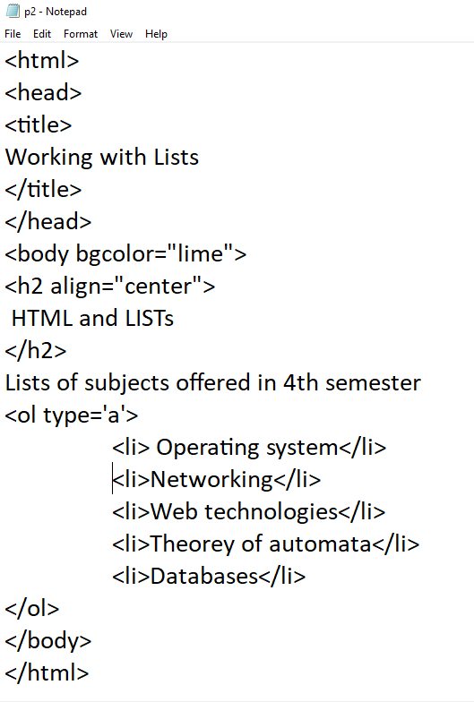
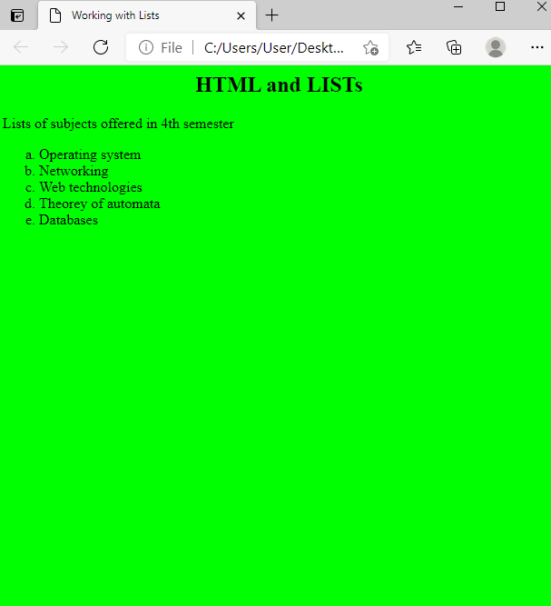
Example

Slide 6
Unordered Lists Tags
• An unordered list is a list in which each item is marked with a symbol.
• Unordered list is also known as unnumbered list.
• <UL> tag is used to create an unordered list. </UL>
should be at the end of the list.
• <LI> tag is used with each of the items in the unordered list. </LI> tag at the end of an item is optional.

Slide 7
Unordered Lists Attribute
TYPE:
Specifies the type of the symbol to appear with each item of the list. Possible values are
FILLROUND, SQUARE, CIRCLE.
The default value is FILLROUND.

Slide 8
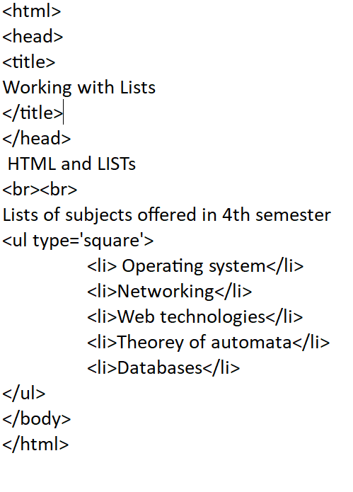
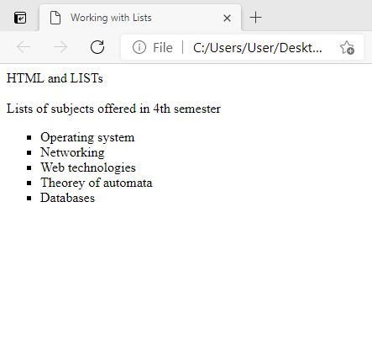

Slide 9
Definition Lists
• Definition list is a list of terms. It consists of terms and description of the terms.
• <DL> tag is used to create a definition list and </DL> is used at the end of the list.
• <DT> tag is used with each term in the definition and
</DT> is used at the end of the term.
• <DD> tag is used with each of the description of the term and </DD> is used at the end of each description.
• Example:
<DL>
<DT> Data.</DT>
<DD>Raw facts about an entity.</DD>
</DL>

Slide 10
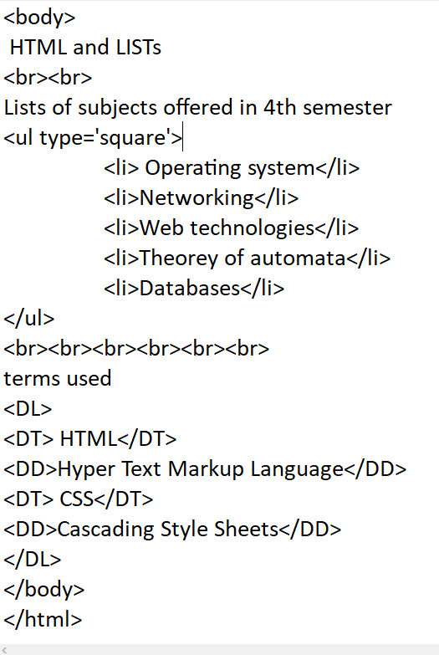
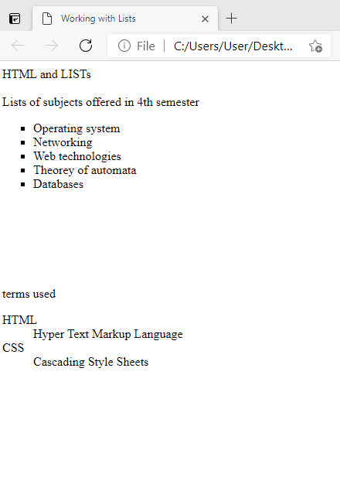

Slide 11
Nested Lists
Defining a list inside of another list is called nested lists.
Lists can be nested in any fashion. Like:
Ordered List inside of Unordered list.
Unordered list inside of Ordered list.
Definition list inside of Ordered list.
Definition list inside of Unordered list.
Ordered list inside of Definition list.
Unordered list inside of Definition list.
Ordered list inside of Ordered list.
Unordered list inside of Unordered list.
Definition list inside of Definition list.

Slide 12
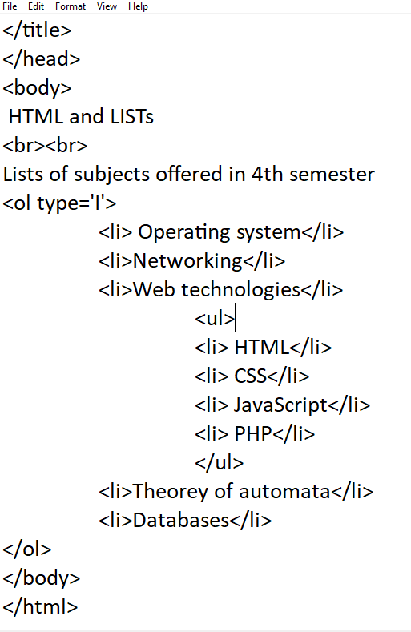
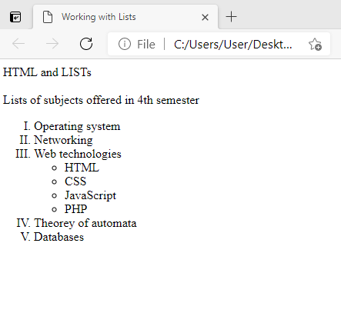

Slide 13
Images in HTML
• A web page may contain different types of graphics and graphics makes websites more attractive and interesting.
• HTML can be used to add both static and animated graphics in websites.
• The images put into a web page are called inline images.
• The popular types of images used in web pages are .GIF, .JPG, .PNG, .BMP.
• <IMG> tag is used to insert images in web pages.
• <IMG> tag has no ending tag.

Slide 14
Images in HTML Attributes
SRC: Specifies the name and path of image to be displayed.
Only name of the image is specified if the image is stored in the same directory in which web page is stored,
otherwise, complete path of the image is specified.
ALIGN: Specifies the alignment of the image with respect to screen. Possible alignment values are left, right, center.
BORDER: Specifies the size of border around the image in pixels.
The possible values are 1, 2, 3, so on. The default value is 0.

Slide 15
Images in HTML Attributes
WIDTH : Specifies the width of the image in pixels or in percentage of the area covered by the browser..
HEIGHT : Specifies the height of the image in pixels or in percentage of the area covered by the browser.
ALT : Specifies the text to be displayed in tool-tip or if the browser cannot display the image.
• Example :
<IMG SRC = “Picture.jpg” ALIGN = “Right” BORDER = “2”>

Slide 16
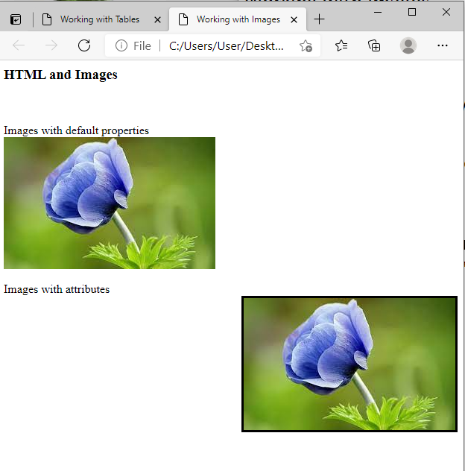
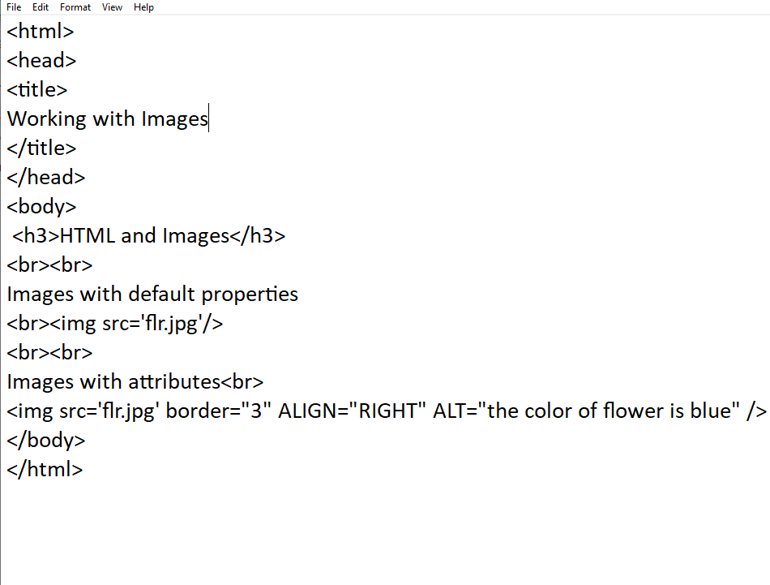

Slide 17
TABLES in HTML
• A table is a two dimensional matrix, consisting of rows and columns.
<TABLE>--</TABLE> tag shows the beginning and ending of a table.
<TR>---</TR> tag is used to define row in a table.
<TD>--</TD> tag is used to define column in a row.
</TH>---</TH> tag is used to define header row (column headers) in a table. Contents is automatically center and appears in boldface.
• <CAPTION>--</CAPTION> element contents (text) is inserted directly above the table in the browser window.

Slide 18
Inserting Table rows <TR> Tag
<TR>--</TR> tag is used to create row in the table.
<TR>--</TR> contains <TD>---</TD> to define the columns in the row.
Attributes are:
ALIGN: Specifies the horizontal alignment of the row. Possible values are Left, Right and Center.
BGCOLOR : Specifies the background color of the row. Its value can be color name or hexadecimal value.
VALIGN : Specifies the vertical alignment of the contents of the row. The possible values are Top, Middle, or Bottom.
<TR ALIGN= “Right” BGCOLOR= “Red” VALIGN = “Top> -- </TR>

Slide 19
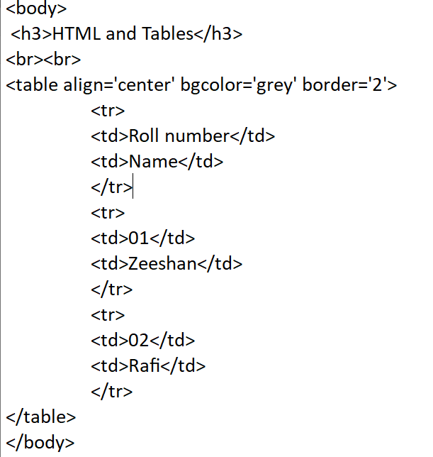
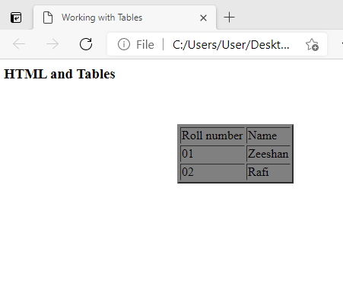

Slide 20
TABLES in HTML Attributes
ALIGN : Specifies the horizontal alignment of the table in the browser window. Possible values are: Left, Right and Center.
VALIGN : Specifies the vertical alignment of cell contents. Possible values are: Top, Bottom and Middle.
WIDTH : Specifies the width of the table. It can be given as number of pixels or as percentage relative to the browser window.
BORDER: Specifies the border thickness of the table. Its value can be any number of pixels.

Slide 21
<CAPTION> Tag
• <CAPTION>--</CAPTION> tag gives information about the contents of the table.
• <CAPTION>--</CAPTION> appears within the <TABLE>--</TABLE> tag.
• The caption can be placed either above or below the table depending on its ALIGN attribute value.
ALIGN : It controls placing of the caption with respect to the table. The possible values can be Bottom, Top.

Slide 22
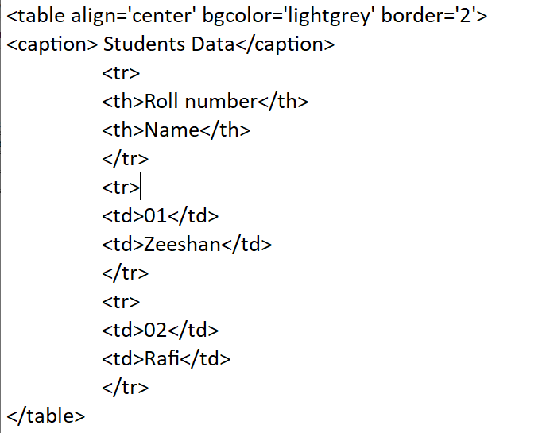
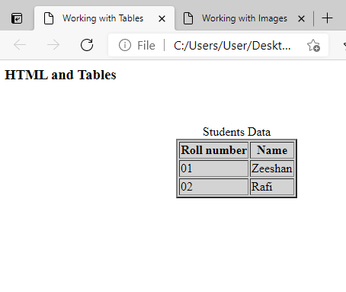
Setting Captions and headers

Slide 23
TABLES in HTML Attributes
CELLPADDING : Specifies the distance between the data in a cell and the boundaries of the cell in pixels.
CELLSPACING : Specifies the spacing between adjacent cells in pixels.
COLSPAN : Specifies the number of columns for a cell. It is used inside <TH> or <TD> tags. A Cell may be consists of many columns.
ROWSPAN : Specifies the number of rows for a cell. It is used inside <TD> tag. A cell may consists of many rows.
Example:
<TABLE ALIGN =“Left” BORDER=“1” CELLPADDING = 5
VALIGN = “Top” CELLSPACING = 2 WIDTH = 90% >

Slide 24
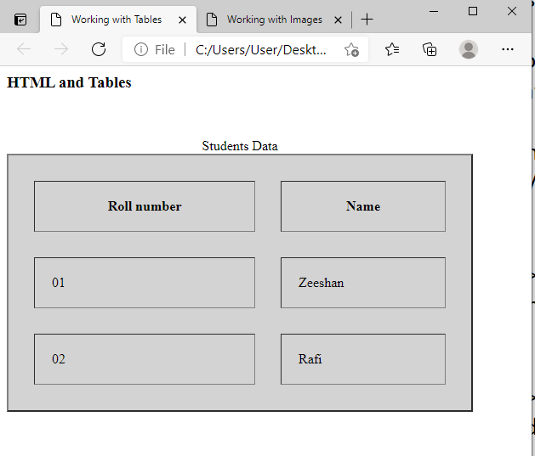
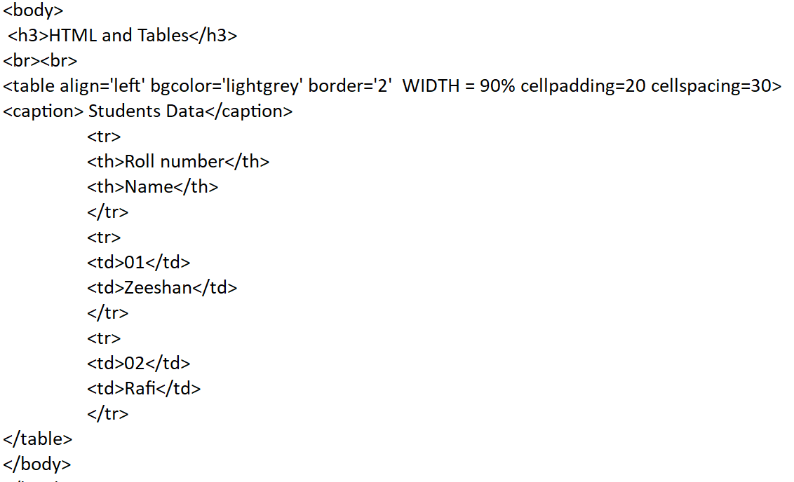

Slide 25
Lab2
Create an ordered list of your semesters and an unordered list of respective subjects in each semester
Insert the university logo at the top right corner in the web page
Create a table of your subjects and respective marks in that subjects

